Slide 1

Consumer Shopping Behavior Analysis for Online Business Start-up
MDA 620 : Capstone Project
Mentor: Prof. Gurpreet Singh
Project by: Naisarg Bhavsar

Slide 2
Table of Contents
Data Exploration
Analyses based on Purchase Amount
Analyses based on Items Purchased for each Category
Analyses for various criteria and its impact on Sales
Relationship and Distribution
Model Running
Conclusion

Slide 3
Objectives and Background
Objectives
Check Sales based on Category and Items
Check relation and distribution impact for sales based on variables
Running model to predict Purchase Amount to get useful insights
Frequency of Items and Discount and other factor’s impact on Sales
Background
Consumer Shopping Behavior impacts on Sales and Business
Various factor required or not for sales and discount to attract the customers
Analyze the sales pattern based on spending and different items for investment purposes
Checking the preferrable locations and Items purchased based on data

Slide 4
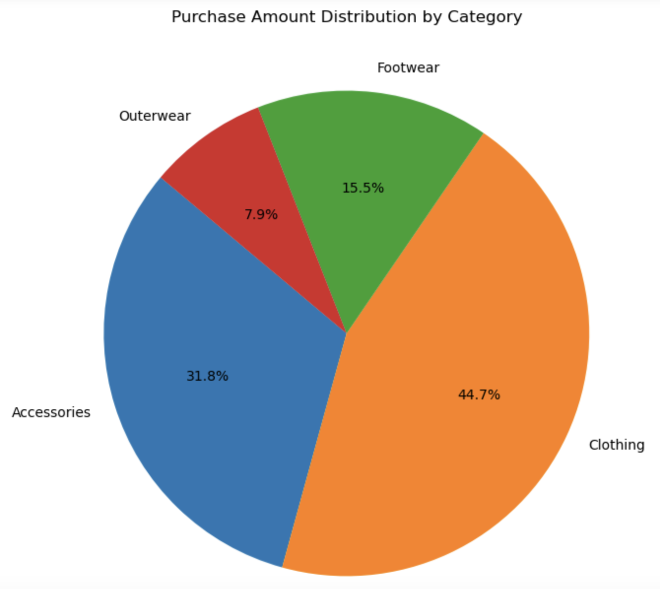
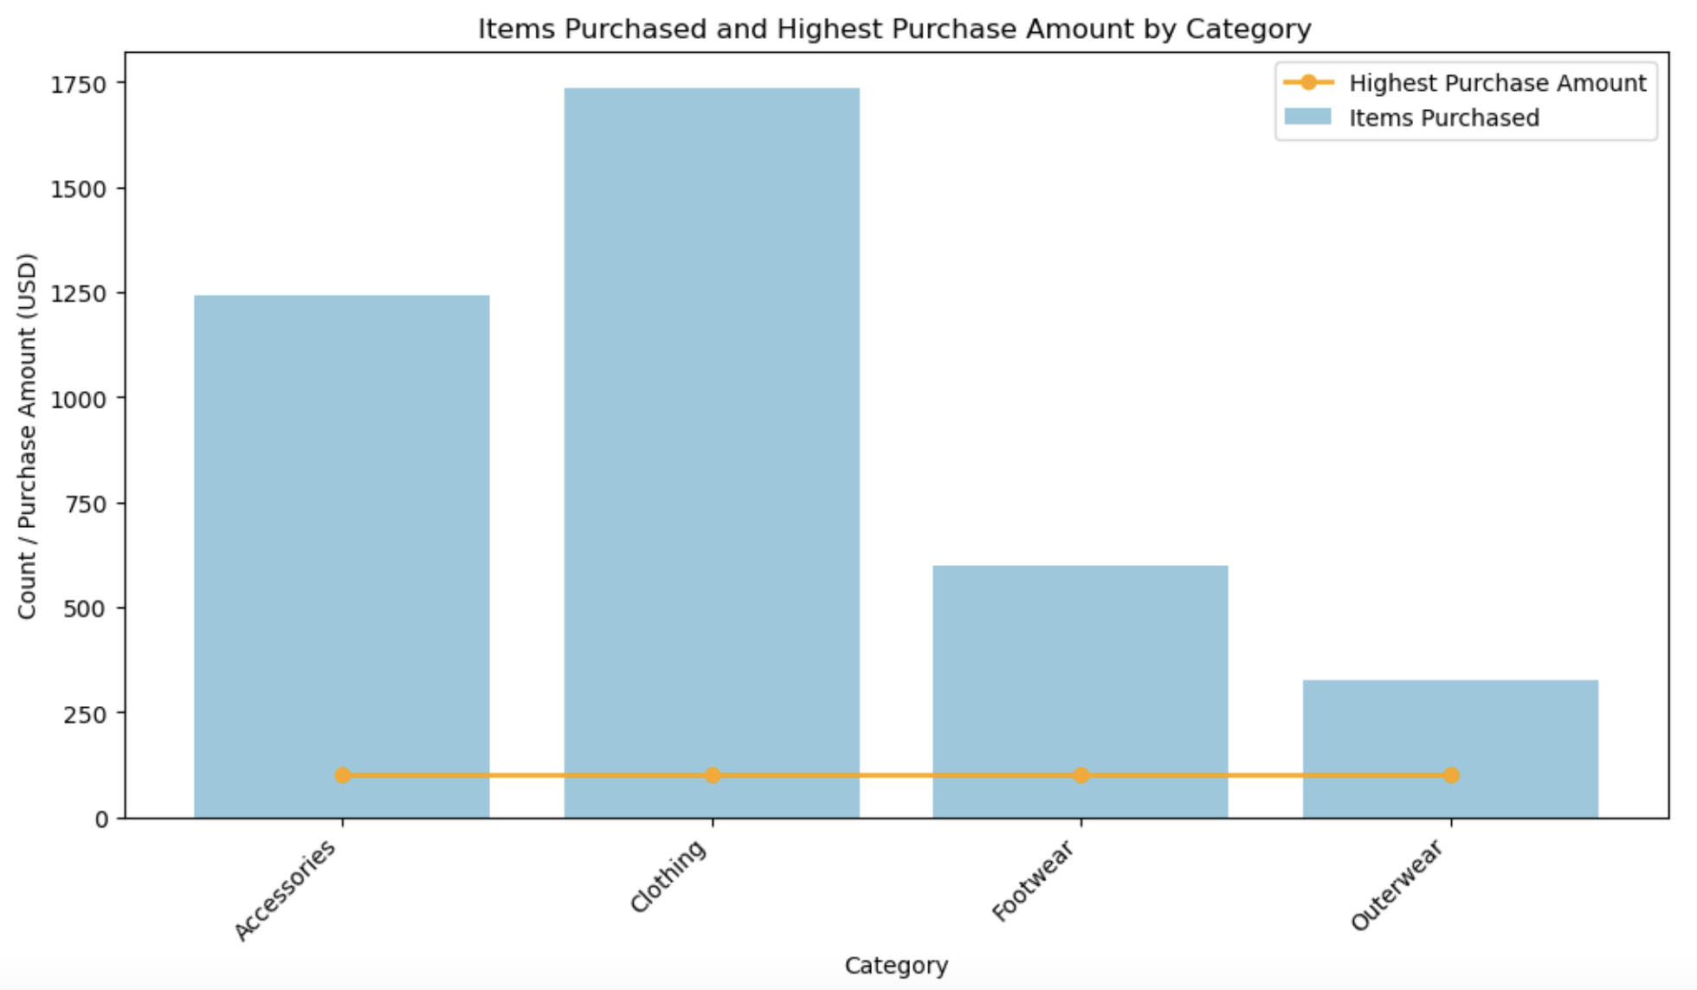
Data Visualization for analyses based on Purchase Amount
Clothing is dominant among all other categories with the 44.7% purchase amount
Accessories being followed up with 31.8%
Clothing are Highest purchased category by worth of $1700 approx.
Outerwear is the lowest purchased with the worth of $250
Almost all categories have the highest purchase amount lies near to $100

Slide 5
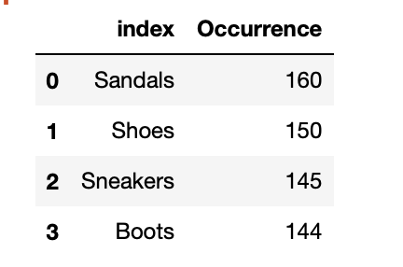
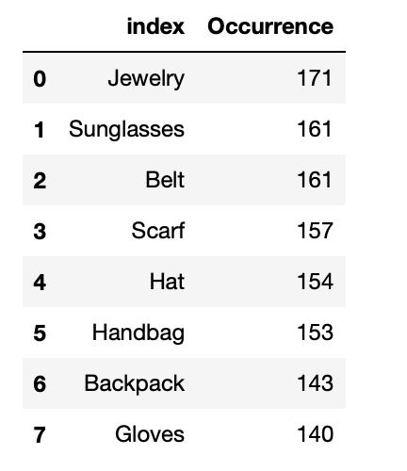
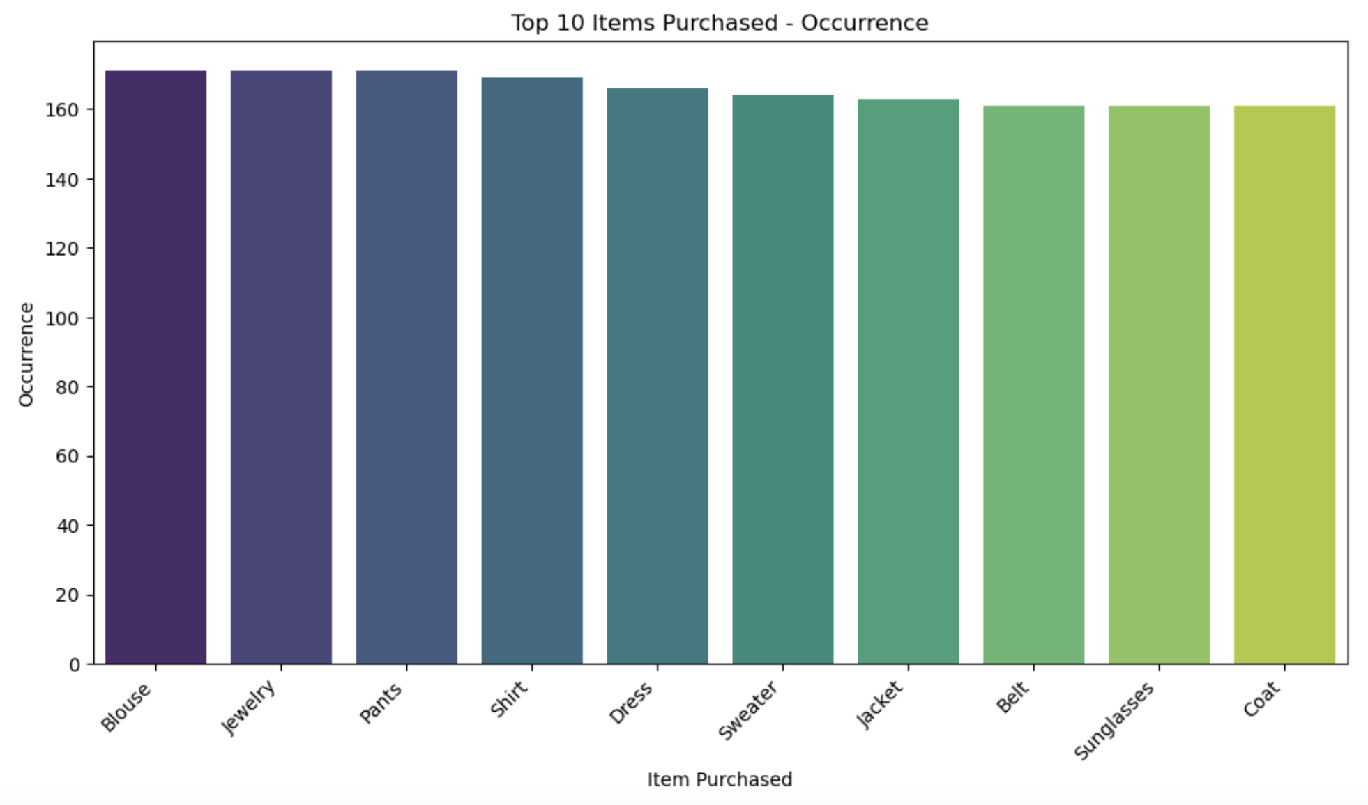
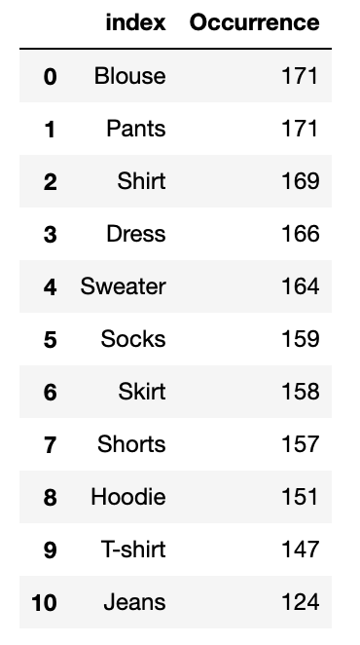
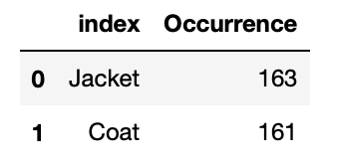
Analyses based on Items Purchased for each Category
Footwear
Accessories
Clothing
Outerwear

Slide 6
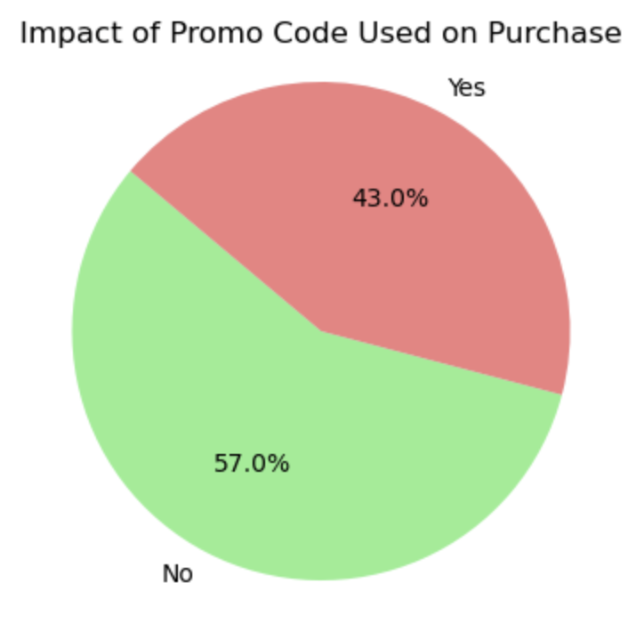
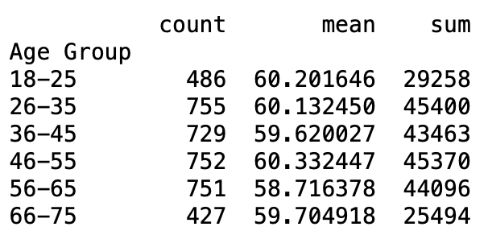
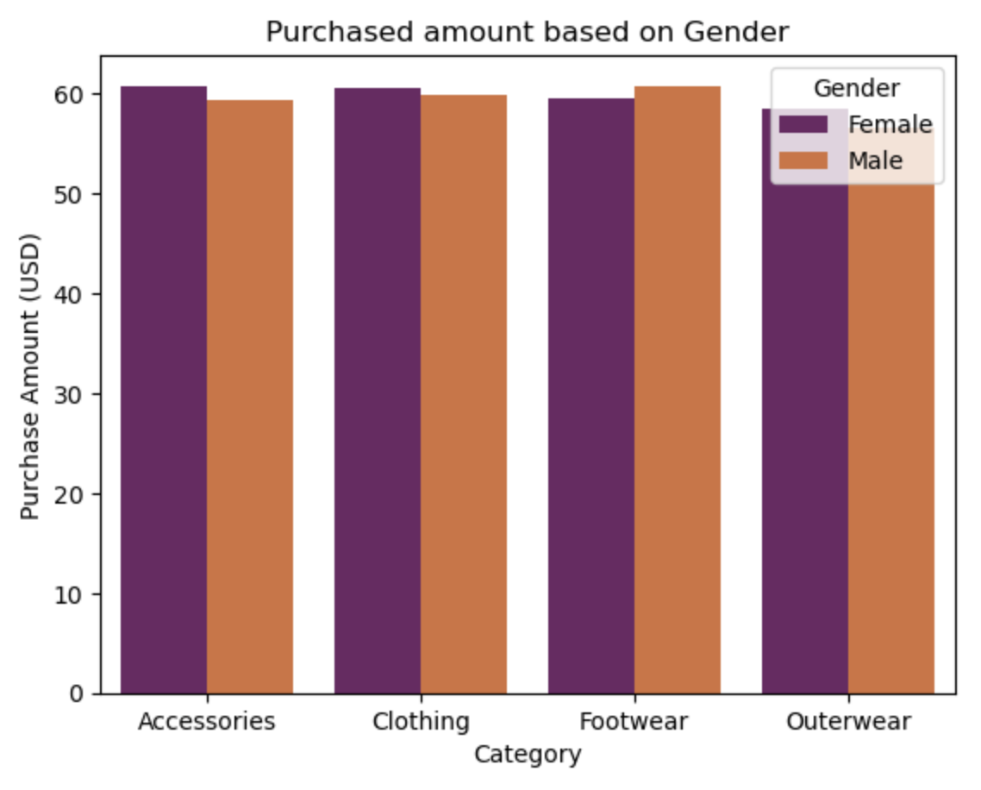
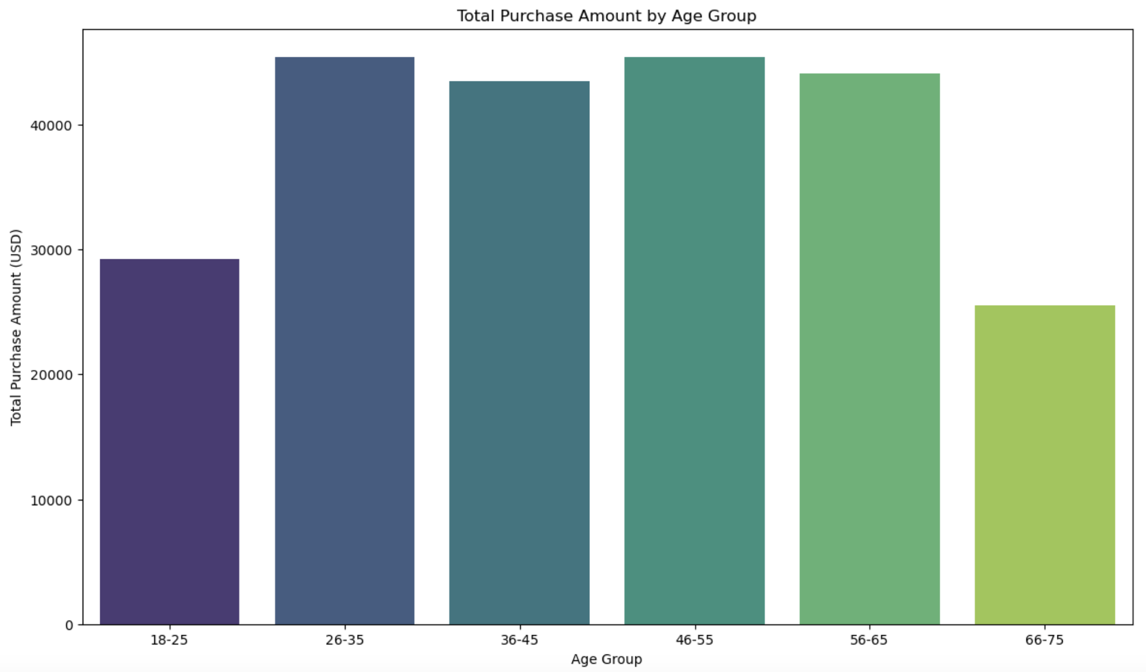
Analyses for various criteria and its impact on Sales
Pretty much sales by attracting the consumers with Promo Code and Discount offers
Adults and Old age customers tend to spend less on shopping
Not huge difference in spendings when it comes to check based on Gender

Slide 7
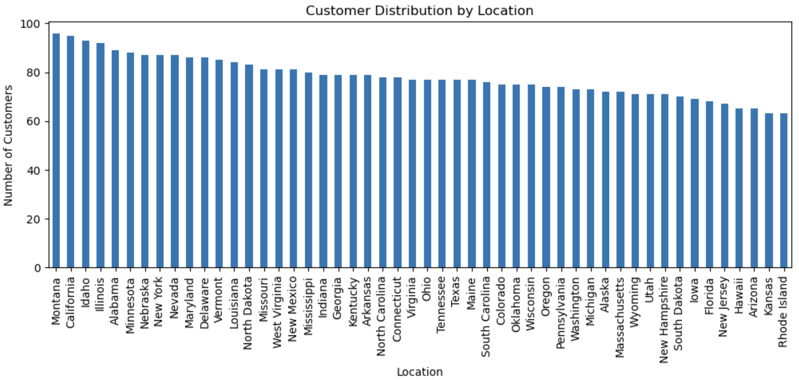
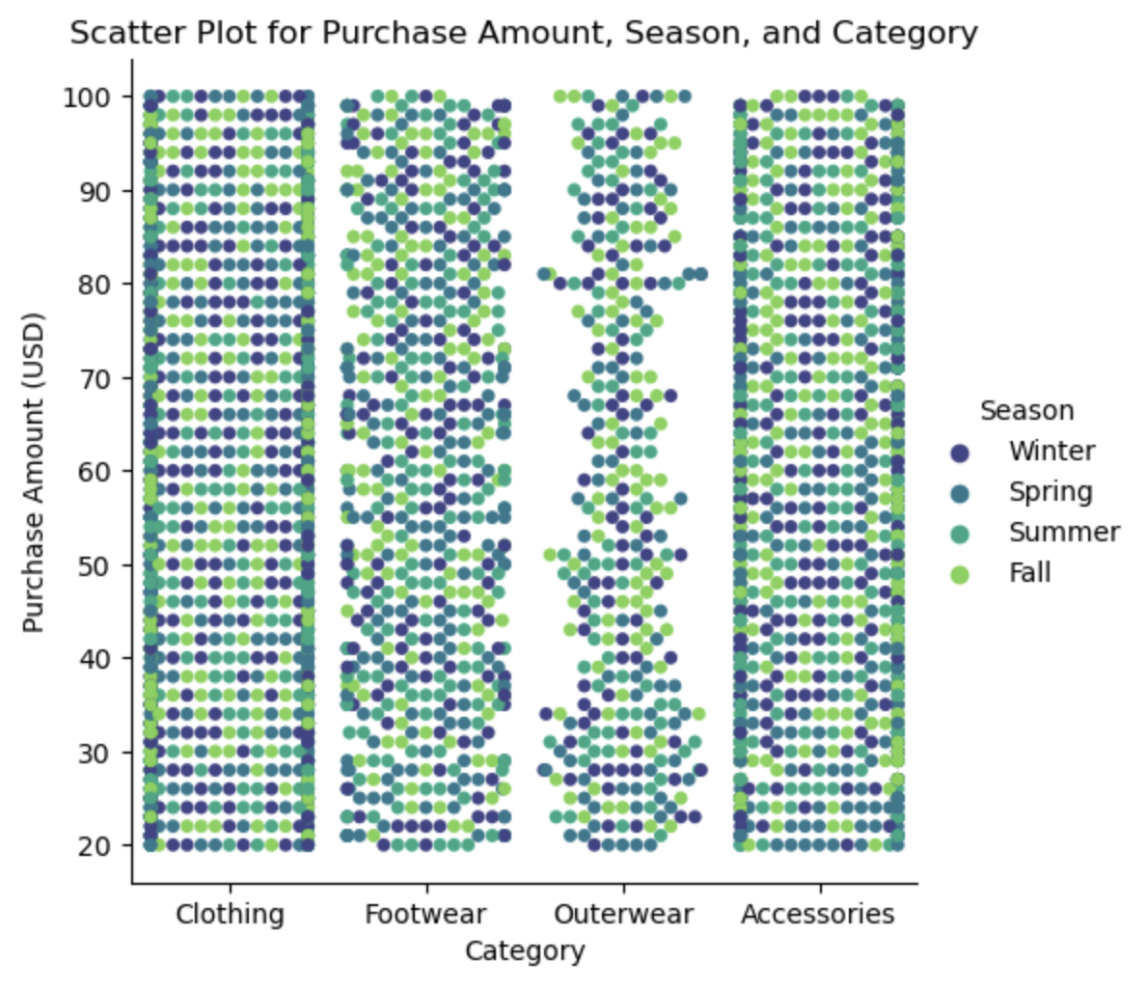
Relationship and Distribution
Montana and California has the most consumers
Outerwear can not be a good idea as per less sales and seasonal impact
Winter and Fall are the best seasons for Accessories
Winter and Summer are preferrable for Clothing

Slide 8
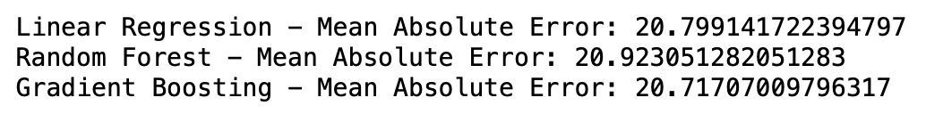
Model Running
Models: Linear Regression, Random Forest and Gradient Boosting
Checked the MSE for all three models to see which one is better for the prediction on Purchase Amount
Relatively small difference between all three models
The lowest value is for Gradient Boosting which may be the best for model selection with further complexity required

Slide 9
Conclusion
Clothing will be the best option for the online business
Accessories are not having any impact based on the seasons which is the best category to stock up
States and Locations does not really matters for the sales and consumer shopping trend
Have to take care of the shipping type and charges based on the purchase amount for the various inexpensive items
Discounts are attractive point for the increasing the volume of sales and consumer
Footwear and Outerwear need to be stock up based on requirement

